Slide 1
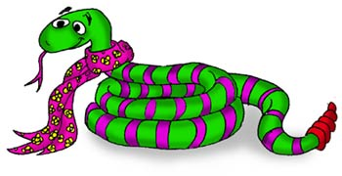
SNAKES (Ophidia)
Dr.Salini Chandran BHMS;PGDMLS
Department of FM & Toxicology
SKHMC, KULASEKHARAM

Slide 2
SNAKES
Poisonous
Non-Poisonous
Classified into

Slide 3
Five families of poisonous snakes
Viperidae
Elapidae
Hydrophidae
Colubridae
Ataspididae

Slide 4
In India
Common krait.(Bengarus caerulus)
Common Cobra (Naja naja)
Saw scaled Viper(Echis carinatus)
Russels viper (Viper russelli)
King cobra

Slide 5
Families of snakes.

Slide 6
Sense organs of snakes
Vision
Eyes without eyelids
For moving objects
Touch
Quite effective
Hearing
No external ear
So doubtful
Smell
Strong smell sensation

Slide 7
Sense organs of snakes
Vibration
Jacobson’s sense organs
Special sensitive cells in the palate
Temperature variation
Pit vipers have pits
On each side of the head
Sensitive to temperature variation
Pythons-on the lips

Slide 8
Poison glands
Salivary glands of snakes
Situated behind the eyes
Above the upper jaw

Slide 9
Fangs
All poisonous snakes have two fangs
Curved teeth
Situated on the maxillary bones
Lie along the jaws
Covered by a flaps of mucous membrane

Slide 10
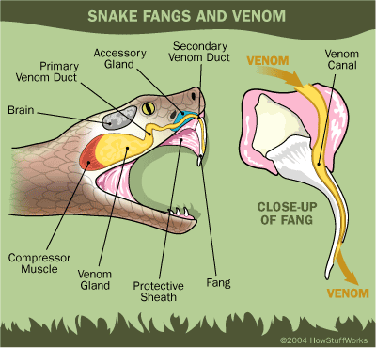

Slide 12
DIFFERENCES BETWEEN POISONOUS & NON- POISONOUS SNAKES
Trait | Poisonous snakes | Non-poisonous snakes
General | Stout, dull coloured,abruptly tapering tail | Slender,bright coloured, gradually tapering tail
Tail | Rounded or flattened | Always rounded
Belly scales | Broad | Small, does not extend across entire width
Head | Usually triangular in shape | Usually rounded or oval

Slide 13
Trait | Poisonous snakes | Non-poisonous snakes
Fangs | Present; Grooved or channellised | All teeth uniform ,not grooved or channellised
Saliva (Venom) | Contains toxic peptides and enzymes | Saliva is non-toxic

Slide 14
COBRA&VIPER
Trait | Cobra | Viper
Body | Long and cylindrical | Short,narrow neck
Head | Small, seldom broader than the body covered with large scales | Larger, triangular.and covered mostly with smaller scales
Pupils | Circular | Vertical,slit-like
Neck | Not prominent | Narrow, prominent

Slide 15
COBRA&VIPER
Trait | Cobra | Viper
Tail | Less tapering | More tapering
Fangs | Shorter and grooved | Longer and channellised
Other teeth | Present in the upper jaw | Absent
Reproductions | Oviparous | Viviparous
Venom | Neurotoxic | Haemolytic

Slide 16
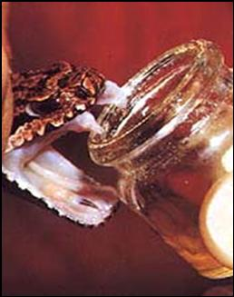
Snake Venom
Clear amber coloured
Proteinous in nature
Most are glycopeptides
Enzymatic in action

Slide 17
Constituents of snake venom
Neurotoxin
Haemolysin
Proteolysin
Fibrinolysin
Cholinesterase
Coagulase
Cardiotoxin
Nucleotidase
Hyaluronidase
RNA ase
DNAase
Histamines
Serotonin
Phospholipidase-A etc

Slide 18
Common krait.(Bengarus caerulus)
3 to4 to5 feet in length
Shining steel black colour
Narrow single or double bands across the back
Belly creamy white
Head is covered with large shields
Four shields on either side of lower lip
Scales on the central row on back are hexagonal
Tail is round
Plates under belly undivided
Venom is NEUROTOXIC

Slide 20
Common Cobra (Naja naja)
5-6 feet
variable colour-usually black
Well marked hood
Double or single spectacle markon the dorsal side
Area surrounding spectacle mark is speckled
Hood cannot be seen in dead cobra
A tiny triangular shield –wedge shield-between 4and5
Infralabials
Caudal scales are double
Venom is NEUROTOXIC

Slide 21
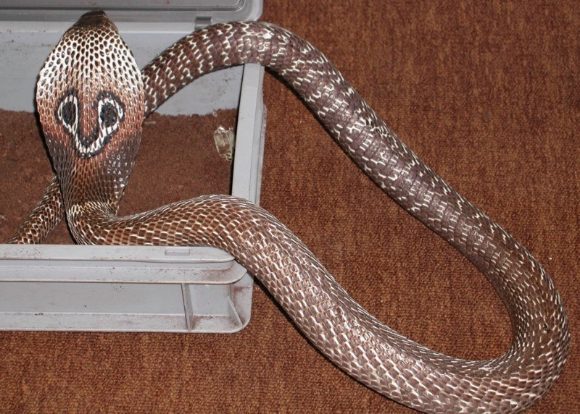
Common Cobra (Naja naja)

Slide 22
Russels viper
Buff or ljght brown colour
4-51/2 feet in length
stouter than other poisonous snakes
Narrows towards tail
Head flat heavy triangular
White V shaped mark with apex pointing forwards
Nostrils bigger
Three rows of brown or black spots along its back
Outer 2 rows-spots ringed with white
Entire broad plates on the belly
Small scales on head
Shields beneath tail divided into two rows

Slide 24
Saw scaled viper (echis carinata)
Length of 1 1 /2 feet
Brown or brownish grey
Head triangular
Upper surface of head-small white mark resembling bird’s foot print
Diamond shaped areas of darker colourbetwwen the upper curves of two wavy lines
Back covered with rough scales
Ridge on the middle of each scale dented like a saw
Broad plates on the belly
Small scales on head
Entire shields beneath tail

Slide 25
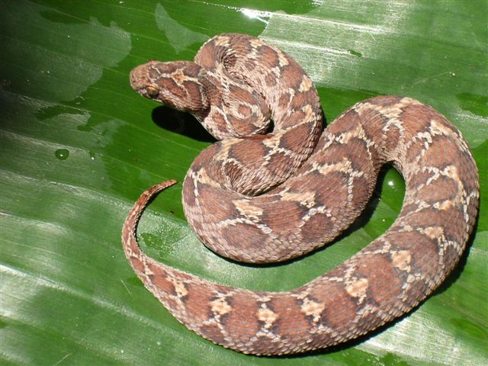
Saw scaled viper (echis carinata)

Slide 26
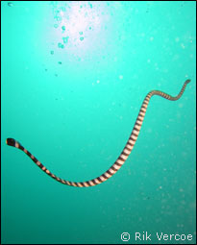
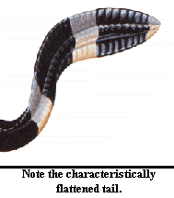
SEA SNAKE

Slide 27
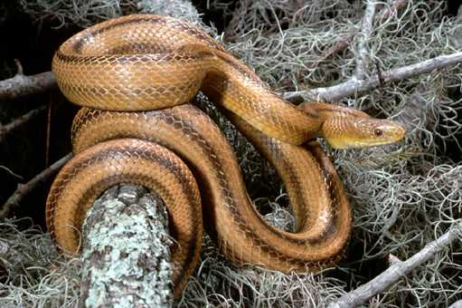
RAT SNAKE

Slide 28
Symptomatology of snake bite
Cobra and krait
Local-
Burning or tingling pain
Redness
Irritation
Swelling
Inflammation

Slide 29
Constitutional
15 mins-1to2 hrs
giddiness
lethargy
Muscular weakness
Drowsiness
Intoxicated feeling
Nausea and vomiting
Weakness of muscles
Develops into paralysis of lower limbs
Staggers or falls on attempt to stand
Paralysis spreads to trunks
Affects the head-droops

Slide 30
Ptosis
Dysphagia and difficulty in talking
Breathing-laboured
Death due to respiratory paralysis
Conscious till end
Krait-convulsions and violent abdominal pain sometimes
Drowsiness more
Pain –lesser
Albumin in urine

Slide 31
RUSSELS VIPER AND ECHIS CARINATE
50% symptomless as little or no venom is injected
spot develops severe pain
area around bite is red and painful
swelling starts within 15 minutes
blood stained discharge from wound

Slide 32
In moderate poisoning
Marked feeling of intense pain
Vomiting
Giddiness
Sweating
Abdominal pain
Dialatation of pupils-get insensitive to light
Marked collapse
Complete loss of consciousness
Skin temperature-raised
Tingling and numbness of tongue mouth or scalp
Paraesthesia around wound
Local extravasation of blood

Slide 33
In severe cases
Main feature is persisting shock
Blood –early haemoconcentration
-then decrease in RBC and platelets
Urine contains blood, sugar,proteins
Bleeding and clotting time-prolonged
Hges from gum, rectum, site of bite
Haemoptysis
Haemoglobinuria and renal failure

Slide 34
In systemic poisoning
Blood becomes defibrinated
Will not clot
Increasing respiratory depression
Giddiness
Headache
Weakness
Towards the end-extensive suppuration and sloughing
Malignant oedema of bitten area
DEATH due to SHOCK and HAEMORRHAGE

Slide 35
SEA SNAKES
Bites cause little or no local reaction
½ to1 hr-
pain
stiffness and
weakness of skeletal muscles
polymyositis with limb girdle distribution
muscle enzymes increased
plasma potassium increased
Myoglobinuria with renal failure
weakness of skeletal muscles persist for months

Slide 36
FATAL DOSE :- Cobra-12mg
Russel’s viper 15mg
Echis-8mg
Krait-6mg
FATAL PERIOD –cobra and krait-1/2 -6hrs
-viper-1-2 days

Slide 37
First aid
Reassure the patient
apply firm pressure over bitten area
Sutherland wrap
Immobilise the bitten limb
Make parallel incisions through fang marks
Clean the wound with sterile saline or water

Slide 38
Treatment
Polyvalent anti snake venom serum
20ml given IV
Repeated 1 hr
Furthur doses every 6 hrs
If not available-antivenin
In viper bite-inject around site also
Neostigmine if there is neuroparalysis
In severe poisoning-normal saline or transfusion of blood and plasma
Haemodialysis or peritoneal dialysis

Slide 39
PM APPEARENCES
One or two fang marks
Colubrine bite-site-haemolysed blood
Viperine-discolouration
swelling
cellulitis
hges
Hges into bowel
Purpuric spots on pericardium
Hges into lungs
Kidneys inflamed
Internal organs-congested

Slide 40
CIRCUMSTANCES OF POISONING
Accidental
Occasionally murder
Occasionally cattle poison

Slide 41
THANK YOU

